Slide 1
Category review: Chips
June 2020
Retail Analytics
Brand note: If client logo is not required, use alternate title page layout right click slide thumbnail > Layout > Title

Slide 2
Notes:
To view Privacy video explaining how important data privacy is to Quantium, please click here: https://www.youtube.com/watch?v=Zq1QDAkoRzU
or here Q:\Company Reference\Brand & Design\Brand videos\Q Privacy.mp4
At Quantium, we believe that data is the behavioural footprint of humanity and that it has to be treated with the utmost care and responsibility.
Histories, attitudes, indeed lives are stored within it in ways that aren’t always apparent – and that’s what makes its potential so powerful.
To work with it responsibly, sensitively, we set ourselves the highest data privacy protection and governance standards.
We have spent 17 years perfecting privacy-by-design and secure-by-design principles. Central to this is not holding any personally identifiable information about people –
we neither receive it, and put the necessary protections in place to be unable to decipher it.
Every aspect of handling data is safeguarded: from its de-identification, to its encryption – data security is paramount and of the highest grade.
We pride ourselves on gaining the trust of iconic organisations around the world through years of securely working with their data,
and in turn the trust that builds with their stakeholders.

Slide 3
Executive summary
From our analytics we can notice that:-
Anyone buys Kettle will have 42.3303% chance of buying Pringles, Smiths and Doritos also.
Anyone buys Doritos will have 25.9809% of buying Kettle.
Anyone buys Smiths will have chance of 29.3686% of buying Kettle.
Anyone buys Pringles will have chance of 28.9772 of buying Kettle also.
Older Families tend to use our budget Premium type while Retirees tend to use our Mainstream premium type
Package size of 175g is sold more than the others
01
Task 1
02
Task 2
The results for trial stores 77 and 88 during the trial period show a significant difference in at least two of the three trial months but this is not the case for trial store 86. We can check with the client if the implementation of the trial was different in trial store 86 but overall, The trial shows a significant increase in sales.
Notes:
Keep in mind the key considerations for a presentation:
Data literacy level of your audience
Table of contents / agenda
Problem statement / purpose
Overview and context
Content balance
Layout and content display
Summary / next steps

Slide 4
01
Customer Analysis

Slide 5
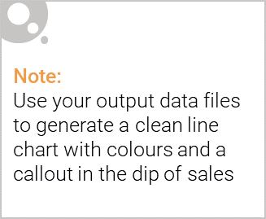
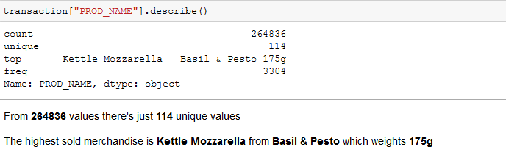
Sales distribution

Slide 6
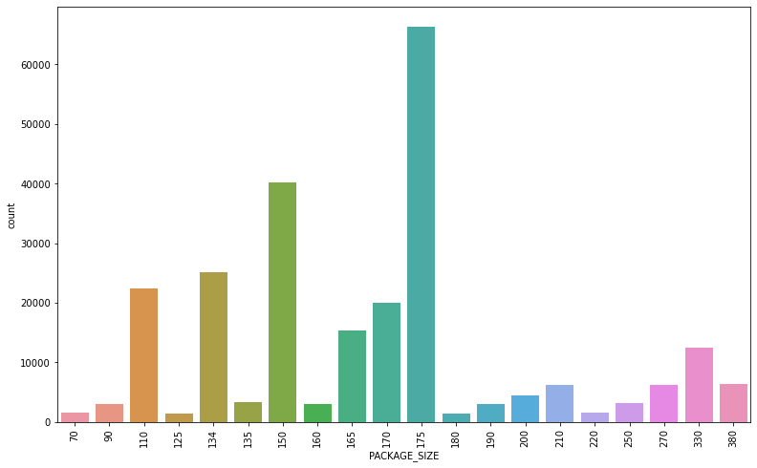
Sales distribution

Slide 7
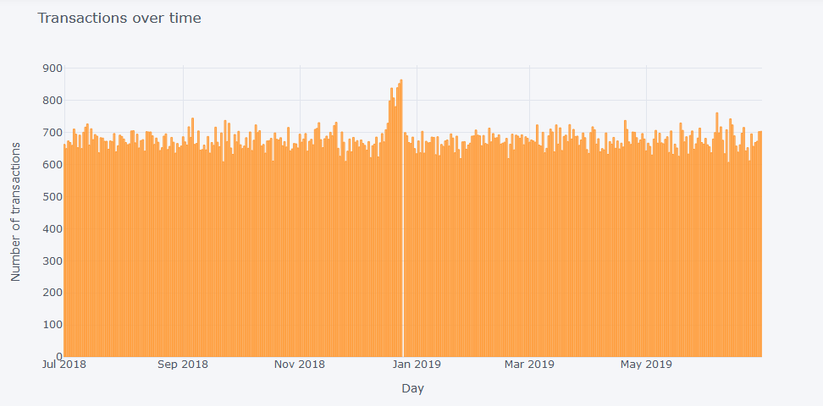
Sales distribution
Notes:
The next slide will show more zoomed into distribution which will show us the white line is what happened on Christmas day so the highest sales will be on the day before the christmas

Slide 8
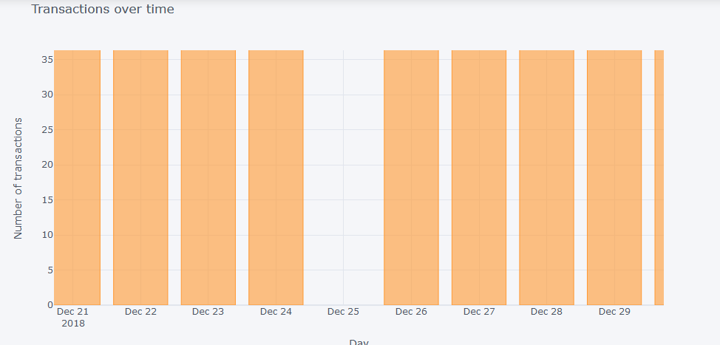
Sales distribution

Slide 9
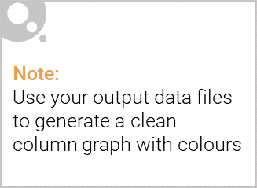
This slide will be commentary on affluence and its effect on consumer buying for the category of chips
Kettle is the most popular brand followed by Smiths, Doritos and Pringles.
Mainstream young singles/couples, retirees are the most common customers and also account for a great share of chips sale.
Budget older families have the maximum contribution to sales.
Mainstream young singles/couples and mid-age single/couples pay more per packet than any other group.

Slide 10
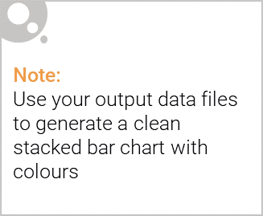
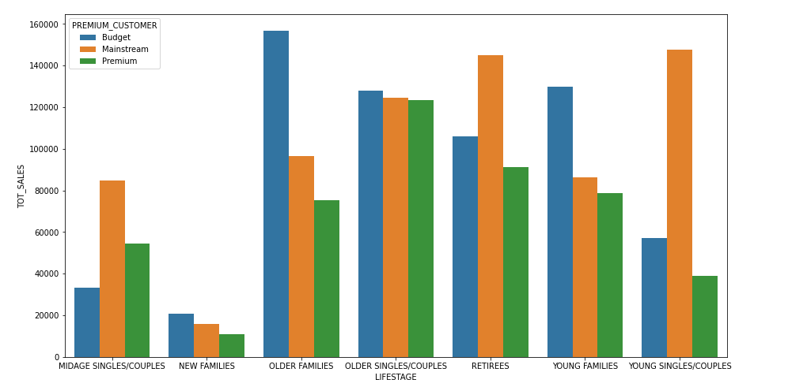
Editable (delete this)
Visualising the proportion of customers by affluence and life stage on this slide
It can be clearly visualized that mainstream young singles/couples, retirees are customers contributing the most

Slide 11
02
Trial store performance

Slide 12
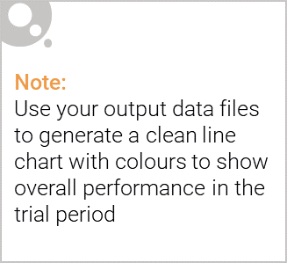
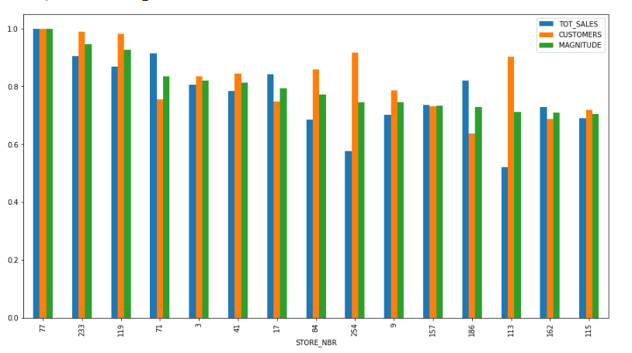
Correlation of the control store 77 vs other stores
Stores with maximum similarities have the highest correlation. So stores 233, 119 and 79 are the most correlated.

Slide 13
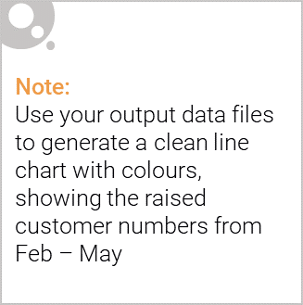
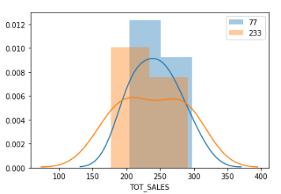
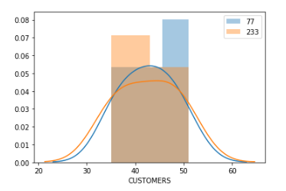
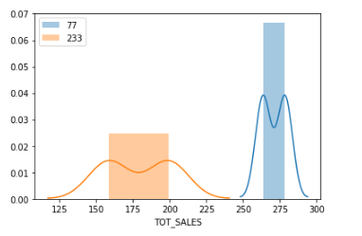
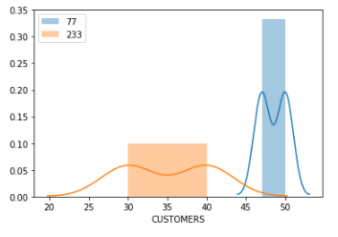
Trial store 77 vs Store 233
Distributions of total sales and customers in pretrial period
Means don’t vary and there is no significant difference
Distributions of total sales and customers in pretrial period
Means vary and there is a significant difference

Slide 14
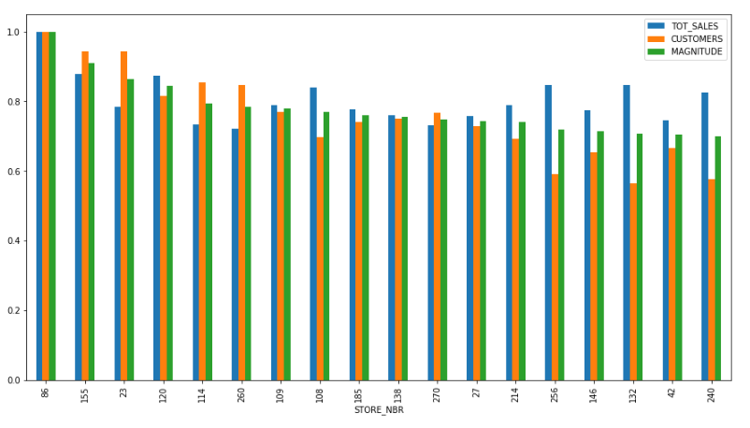
Correlation of the control store 86 vs other stores
Stores with maximum similarities have the highest correlation. So stores 255, 23 and 120 are the most correlated.

Slide 15
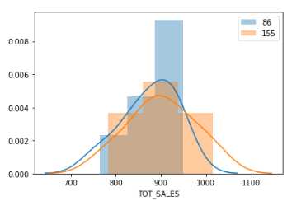
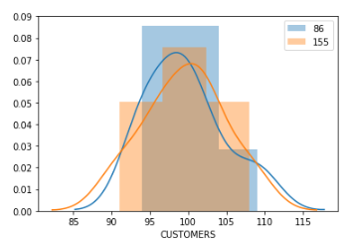
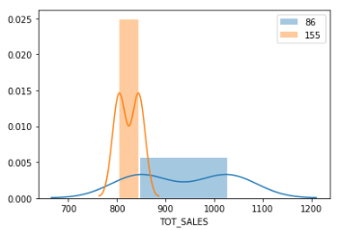
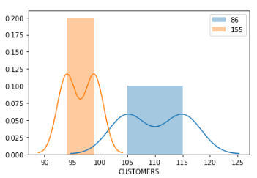
Trial store 86 vs Store 155
Distributions of total sales and customers in pretrial period
Means don’t vary and there is no significant difference
Distributions of total sales and customers in pretrial period
Means vary and there is a significant difference

Slide 16
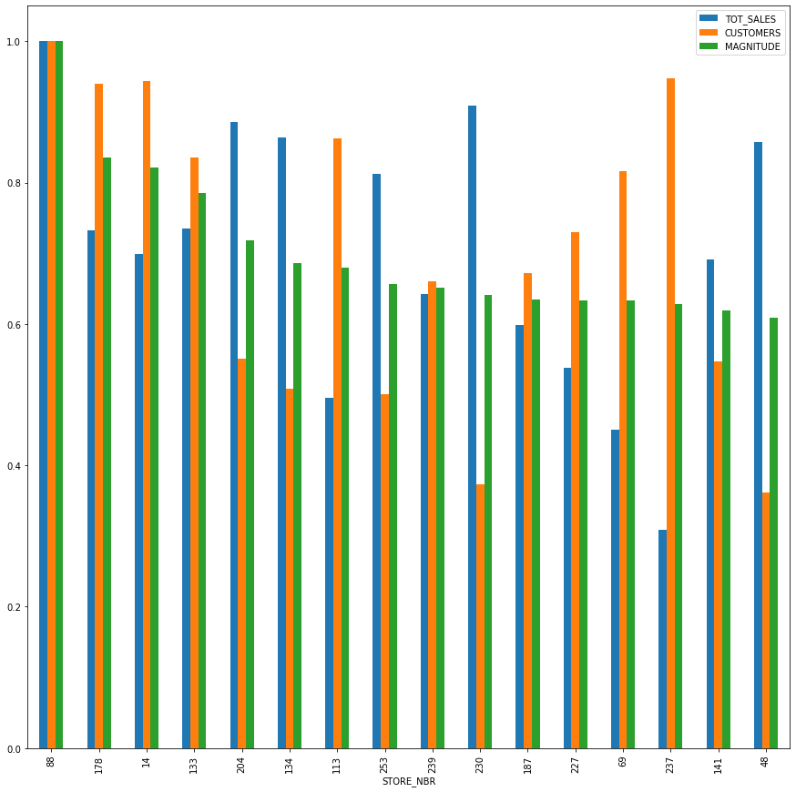
Correlation of the control store 88 vs other stores
Stores with maximum similarities have the highest correlation. So stores 237, 178 and 14 are the most correlated.

Slide 17
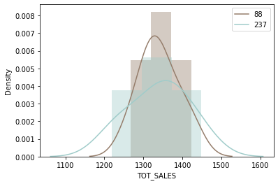
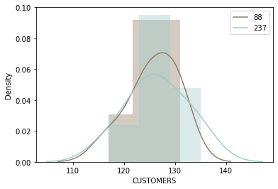
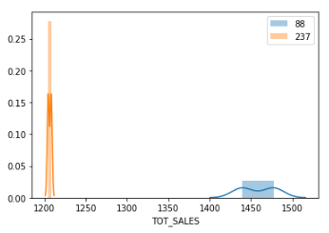
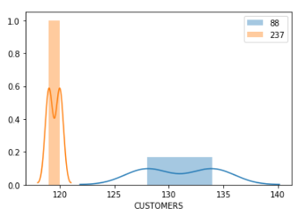
Trial store 88 vs Store 237 – Similarly selecting store 237 as trial store for store 88
Distributions of total sales and customers in pretrial period
Means don’t vary and there is no significant difference
Distributions of total sales and customers in pretrial period
Means vary and there is a significant difference

Slide 18
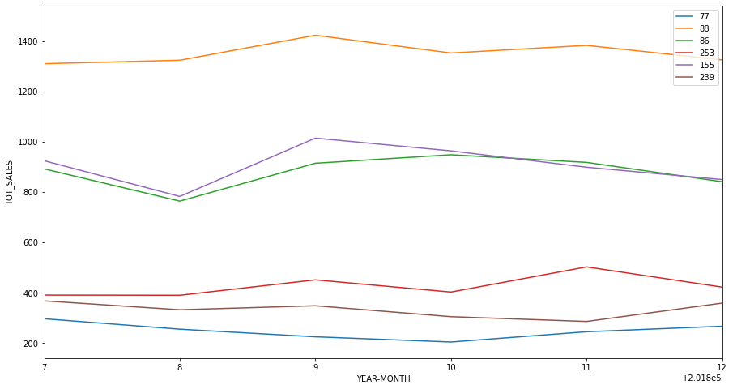
The control store were set up to measure sales whether trial store are doing better during the trial period or not.
2018

Slide 19
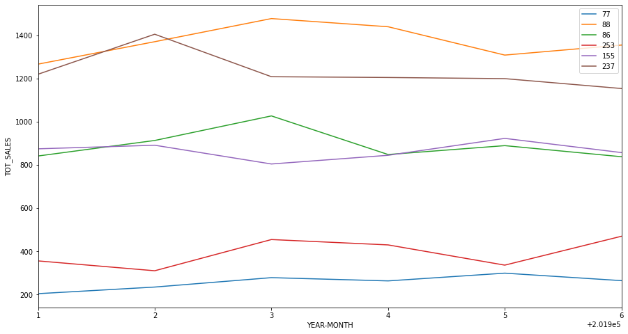
The control store were set up to measure sales whether trial store are doing better during the trial period or not.
2019

Slide 20
Conclusion
We've found control stores 233, 155, 239 for trial stores 77, 86 and 88 respectively.
The results for trial stores 77 and 88 during the trial period show a significant difference in at least two of the three trial months but this is not the case for trial store 86.
We can check with the client if the implementation of the trial was different in trial store 86 but overall, the trial shows a significant increase in sales.
Recommendations
Stocks should be high in December before the Christmas
Kettle, Smiths, Doritos and Pringles should be kept in stocks as they are the most sold
Mainstream young singles/couples, retirees are the account for a great share of chips sale so they need much attention.
Budget older families have the maximum contribution to sales.
Control stores 233, 155, 239 for trial stores 77, 86 and 88 respectively would be a good choice

